Slide 1
Summer School Overview
Day 0: R bootcamp
Day 1: Workflow, Google App Engine
Day 2: Online Experiments
Day 3: Data wrangling, visualization
Day 4: Statistics, Probabilistic models
Day 5: Experience sampling

Slide 2
Announcements

Slide 3
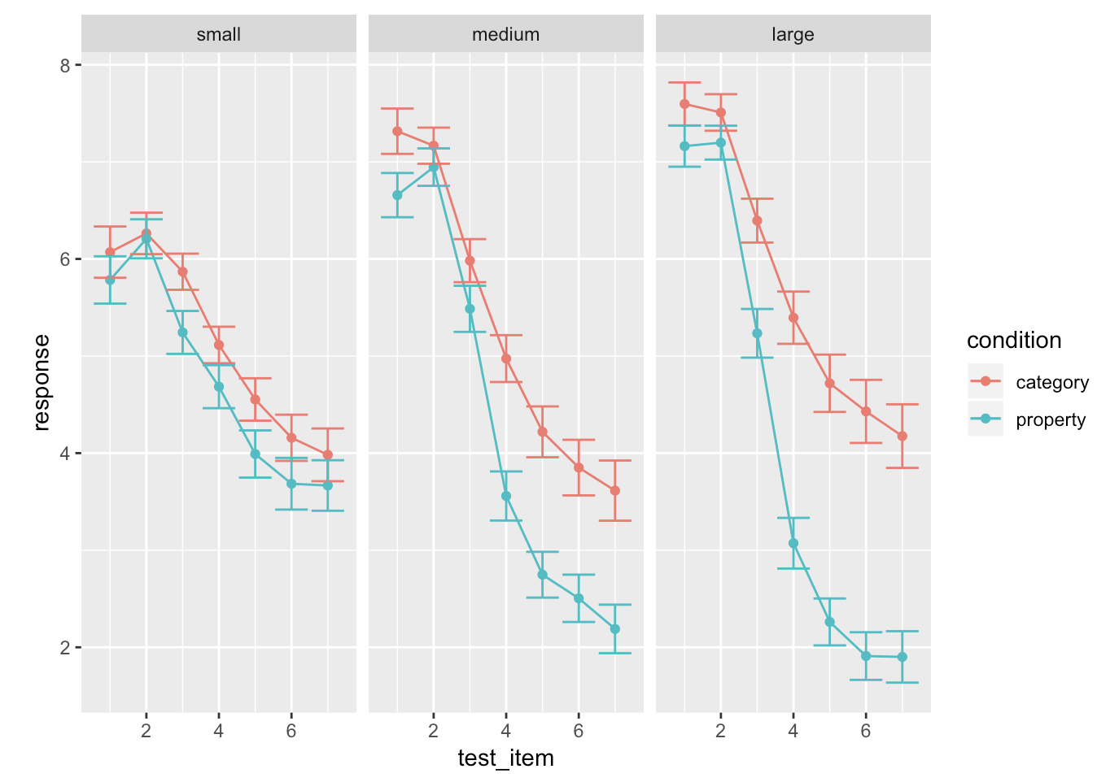
Goals
Introduce some statistical concepts, including Bayesian approaches and mixed effects models
Work towards a statistical analysis of the sampling frames data

Slide 4
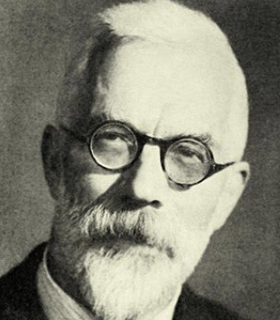
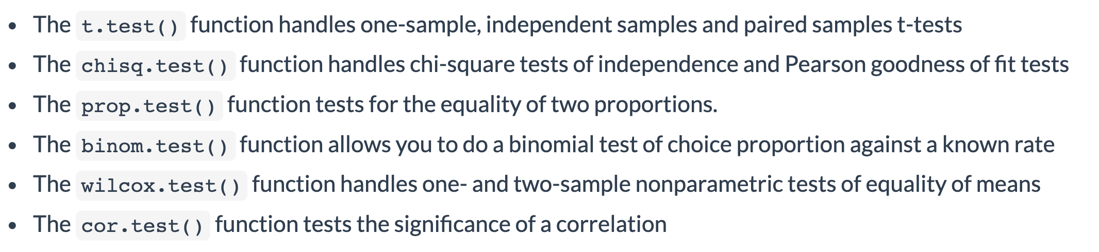
Classical tests

Slide 5
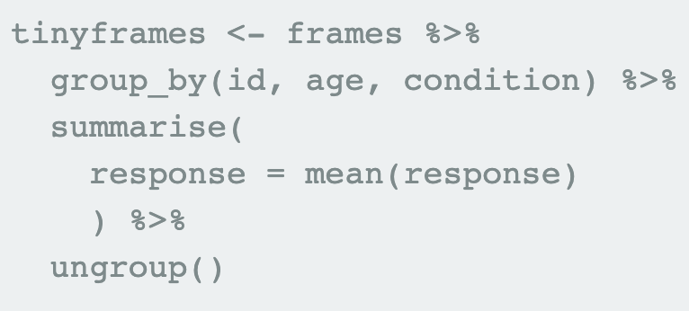
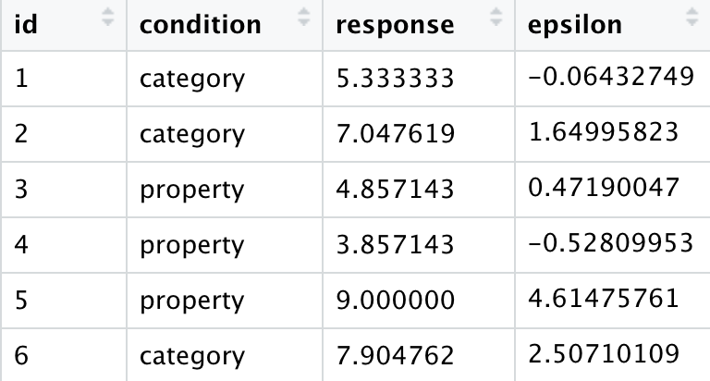
tinyframes data

Slide 6
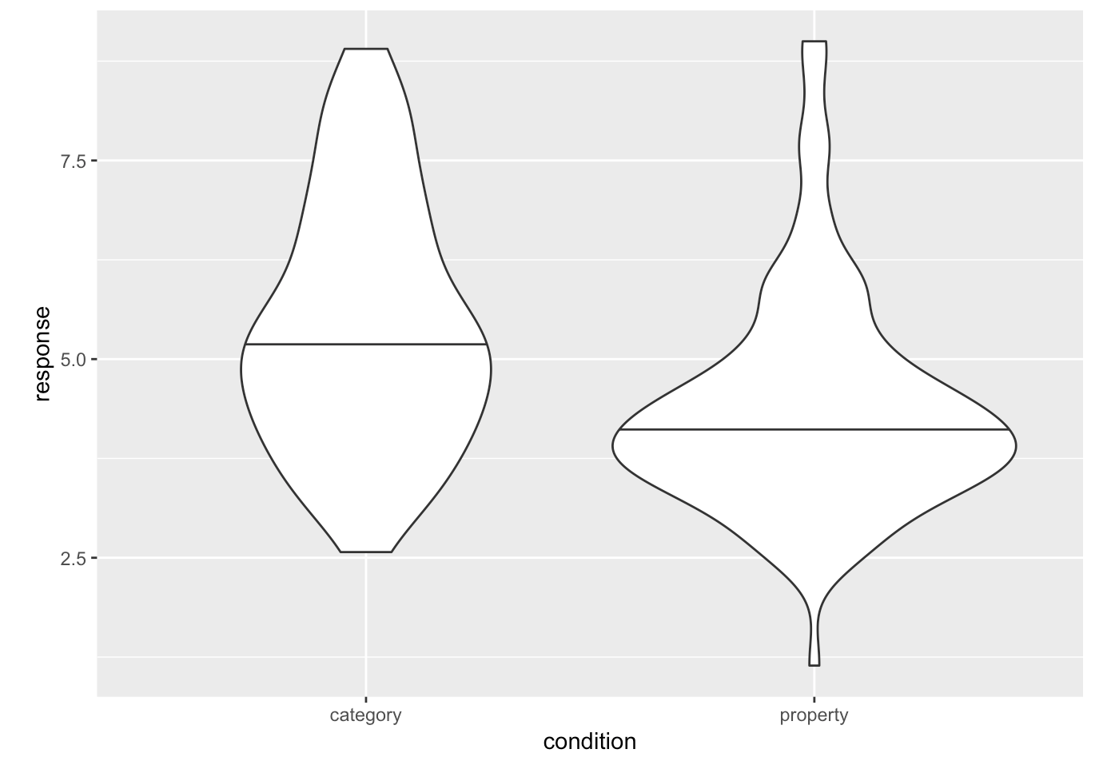
tinyframes data

Slide 7
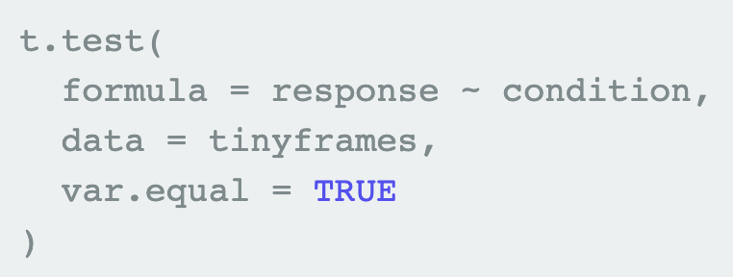
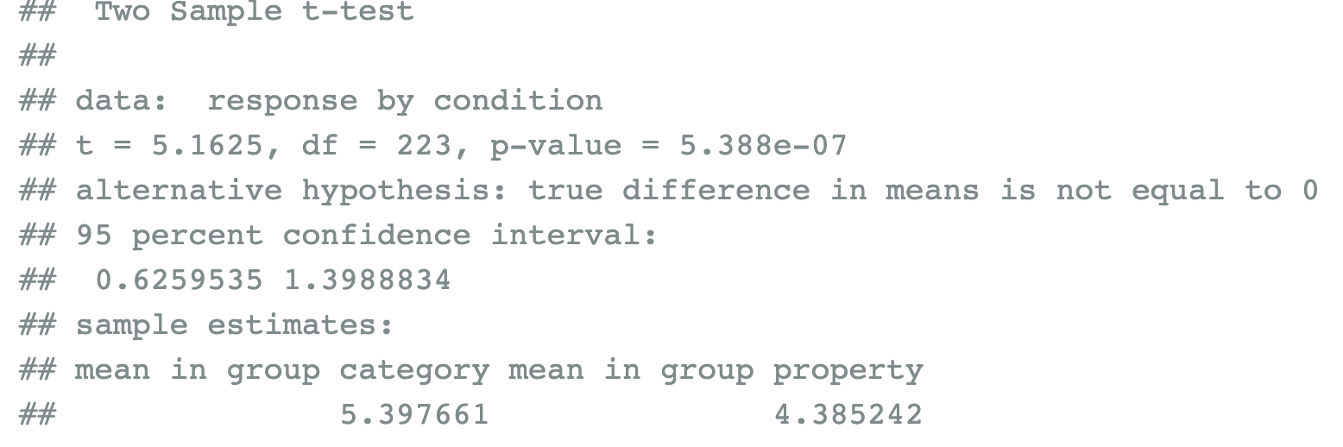
t-test

Slide 8
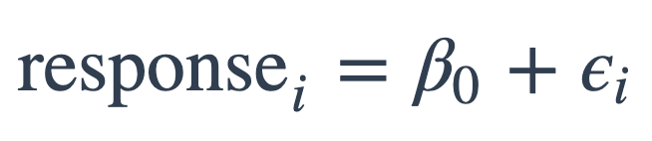
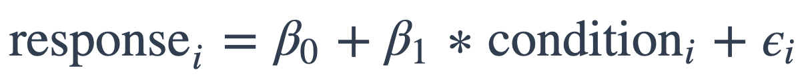
From a t-test to linear models
mod1:
mod2:

Slide 9
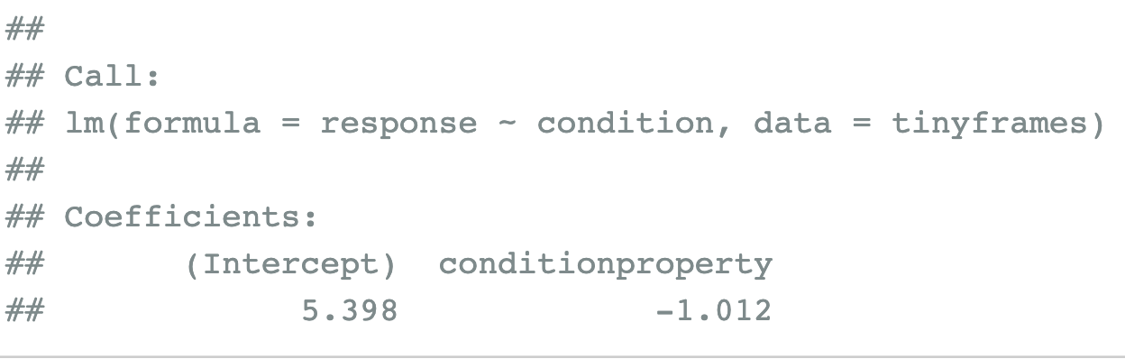
From a t-test to linear models
mod1:
mod2:

Slide 10
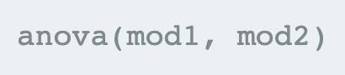
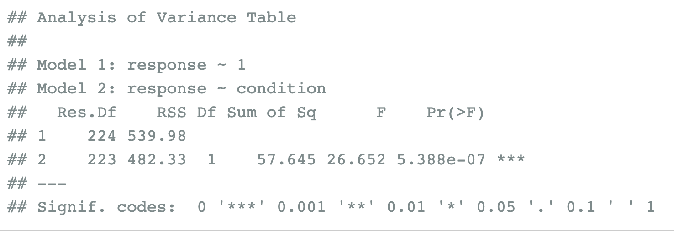
ANOVA for model comparison
mod1:
mod2:

Slide 11
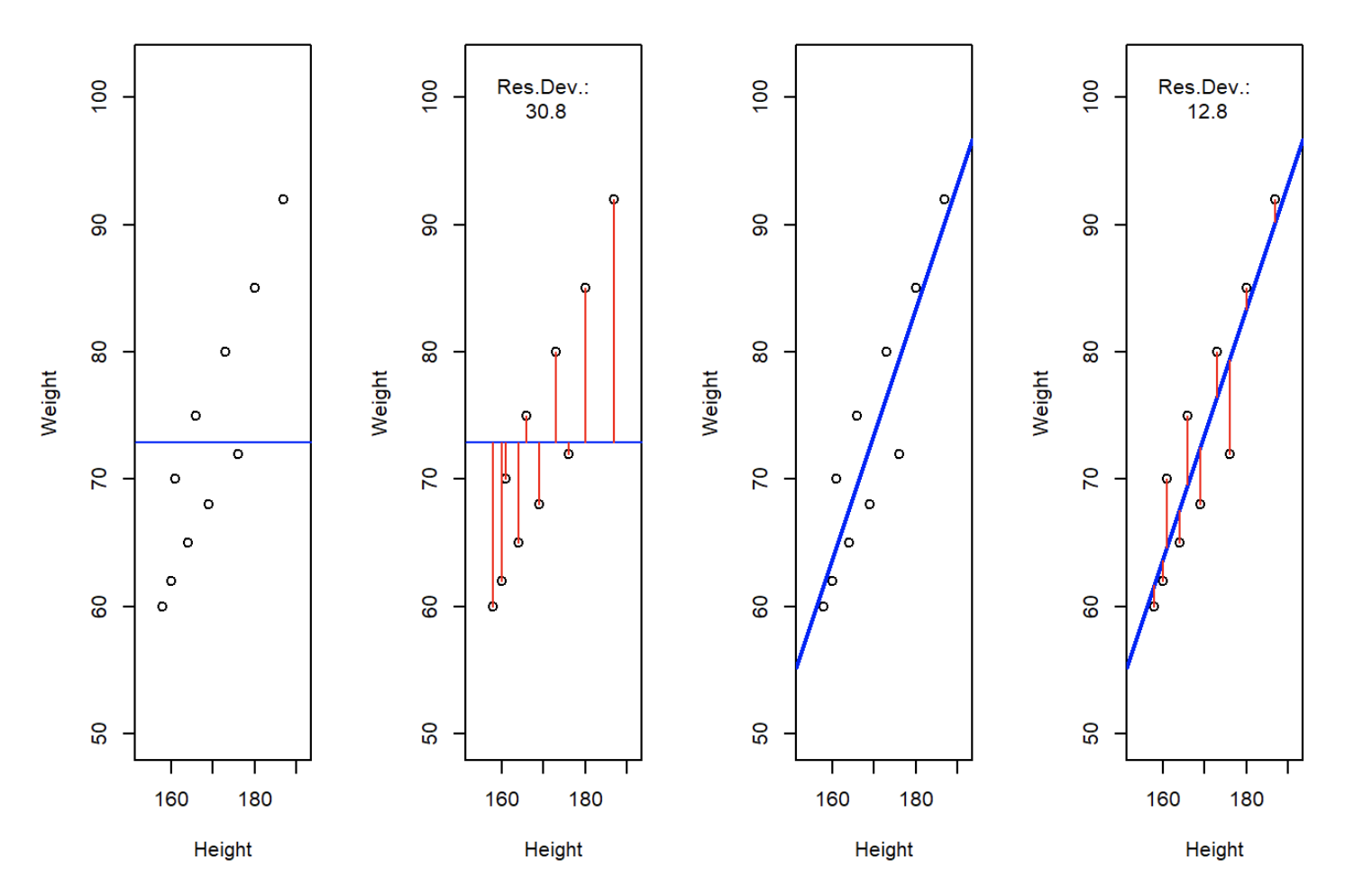
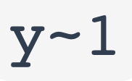
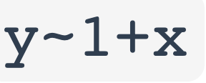
Least squares regression

Slide 12
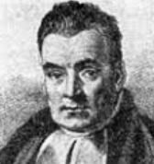
Coughing patient
d: Jen is coughing
h₁: Jen has a cold h₂: Jen has emphysema h₃: Jen has a stomach upset
Posterior
probability
Evidence
(Likelihood)
Prior
knowledge
P(h|d) = P(d|h) P(h)
P(d)
Notes:
Sketch bar graphs on the board

Slide 13
Coughing patient
d: Jen is coughing
h₁: Jen has a cold h₂: Jen has emphysema h₃: Jen has a stomach upset
Posterior
probability
Evidence
(Likelihood)
Prior
knowledge
P(h|d) α P(d|h) P(h)
Notes:
Sketch bar graphs on the board

Slide 14
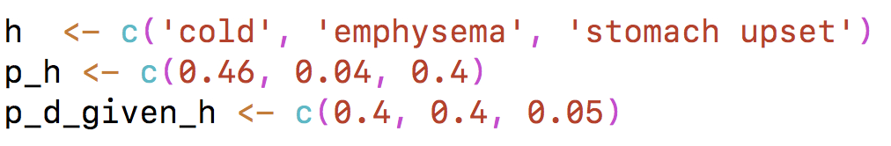
Specifying prior and likelihood

Slide 15
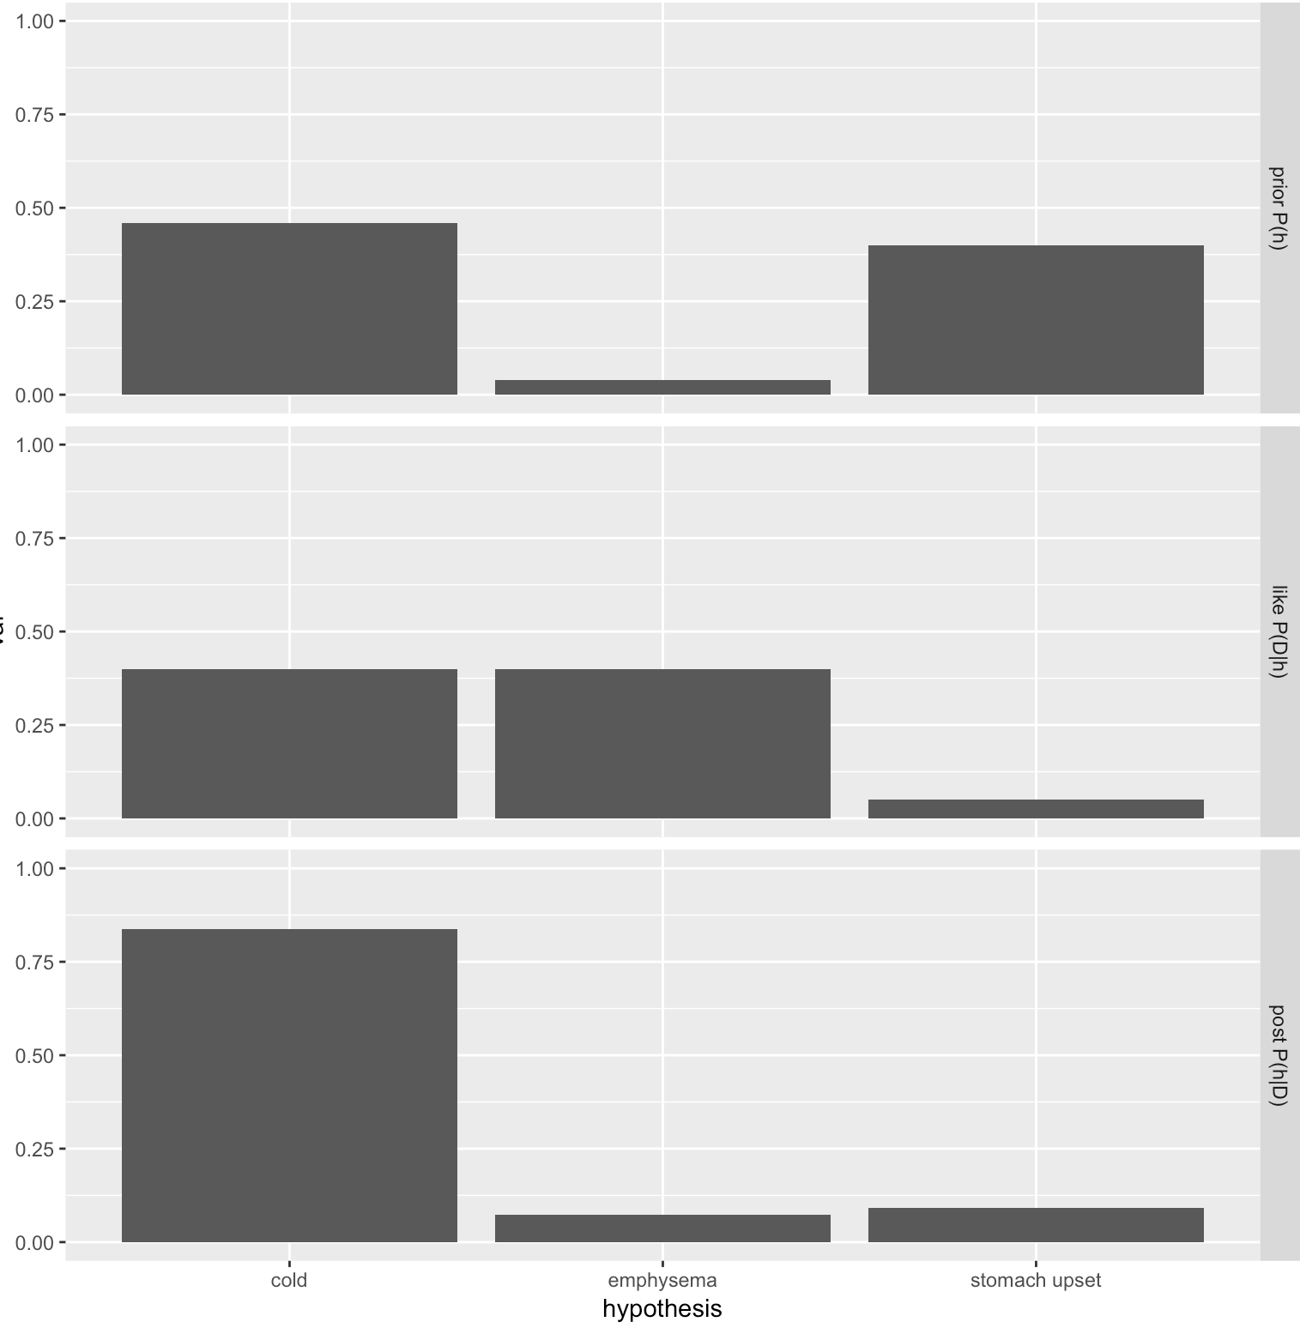
prior
likelihood
posterior

Slide 16
Exercise: Coughing patient

Slide 17
Bayesian inference
Two distinct applications:
Bayesian Data analysis
Bayesian cognitive models

Slide 18
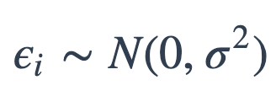
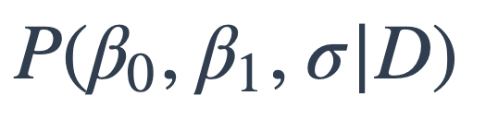
Bayesian regression
M₁:
M₂:
Both models assume
Fitting M₂: compute
where D is the observed data

Slide 19

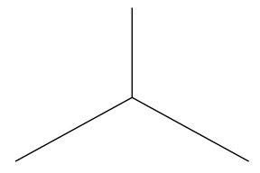


Bayesian regression
prior
likelihood
posterior

Slide 20

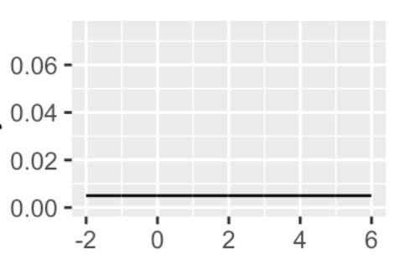
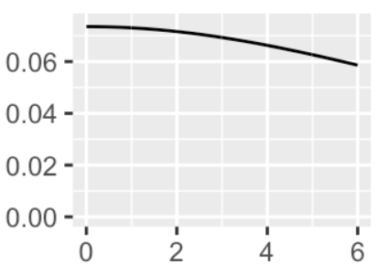
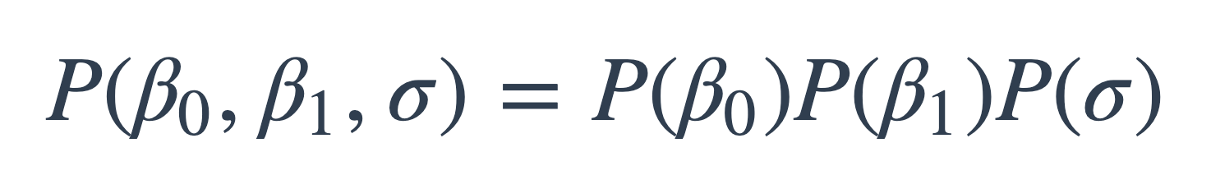
Bayesian inference
prior
Assume

Slide 21
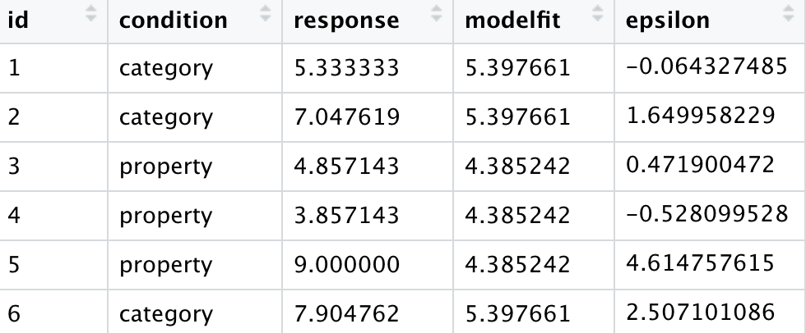
Bayesian inference
likelihood

Slide 22
Bayesian inference
likelihood

Slide 23

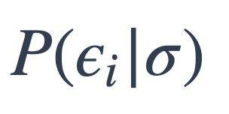
Bayesian inference
likelihood
…

Slide 24
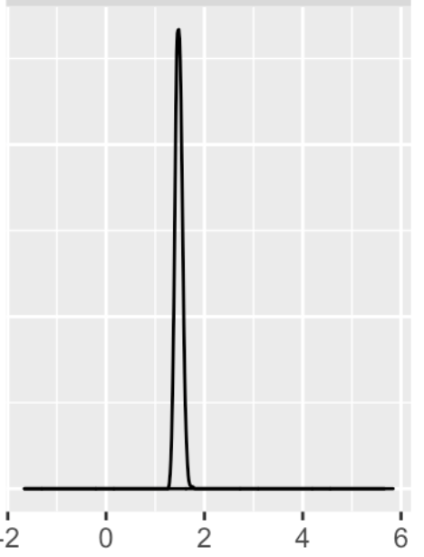
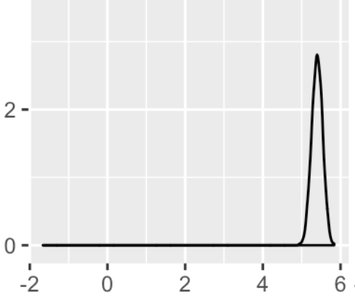
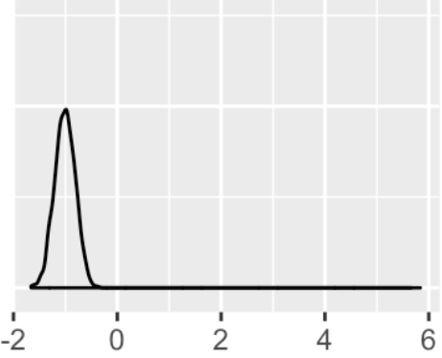
Bayesian inference
prior
posterior

Slide 25
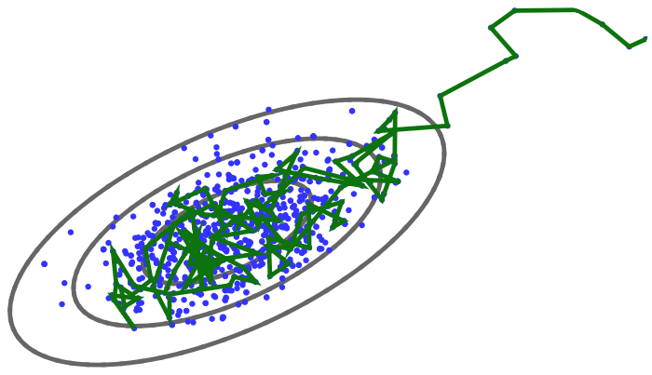
Markov-Chain Monte Carlo (MCMC) methods

Slide 26
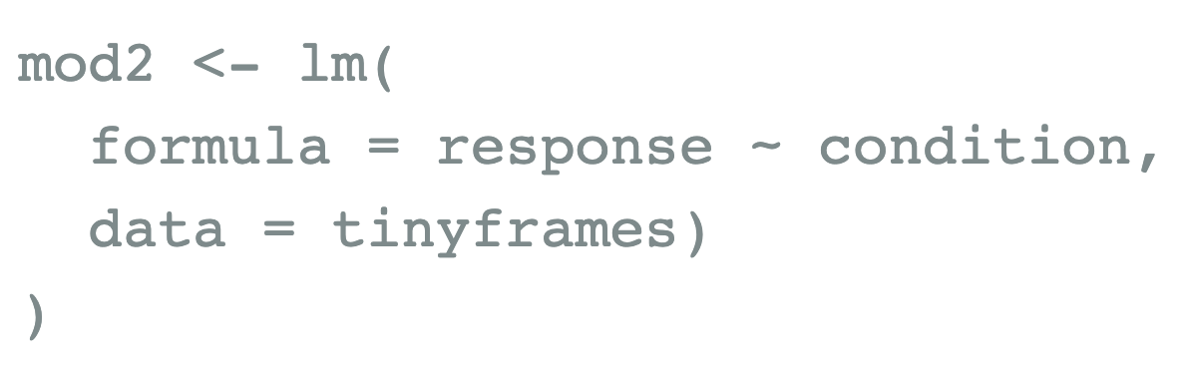
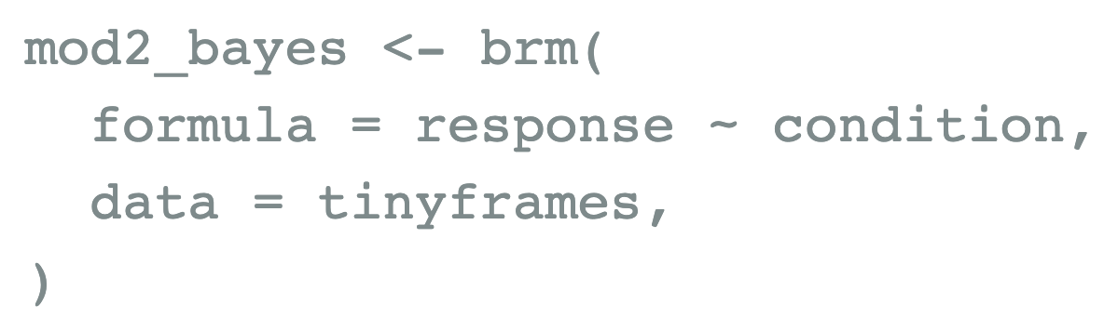
Regression
Least-squares:
Bayesian:

Slide 27
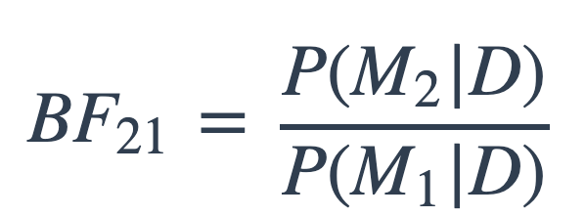
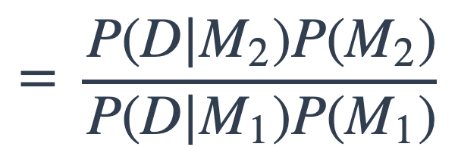
Bayes factors for model comparison
M₁:
M₂:

Slide 28
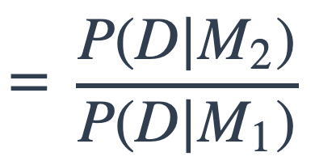
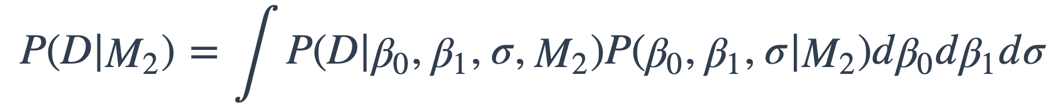
Bayes factors for model comparison
M₁:
M₂:

Slide 29
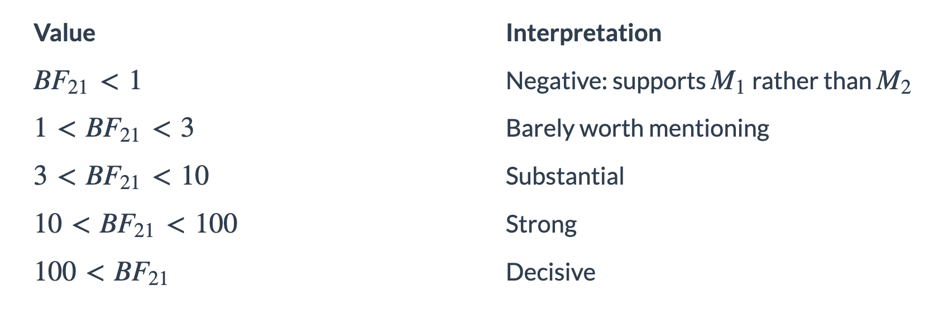
Bayes factors for model comparison

Slide 30
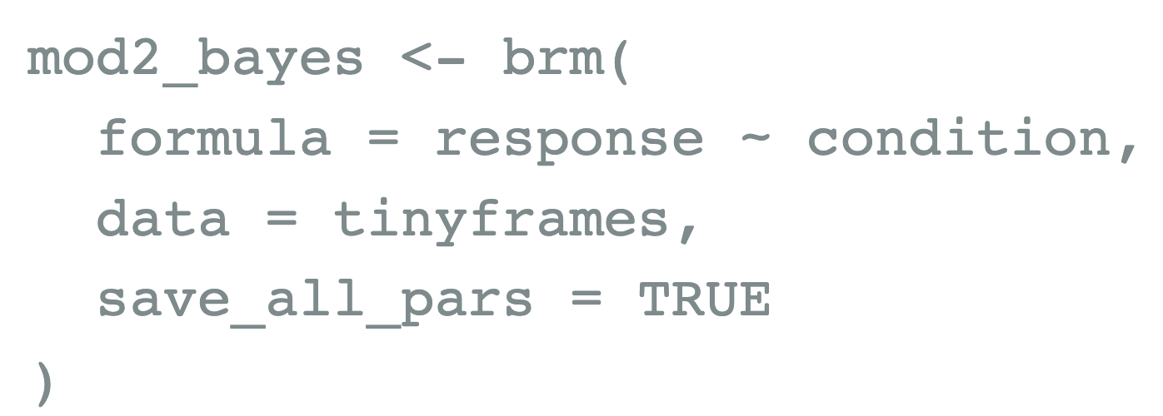
Bayes factors for model comparison
mod1:
mod2:

Slide 31
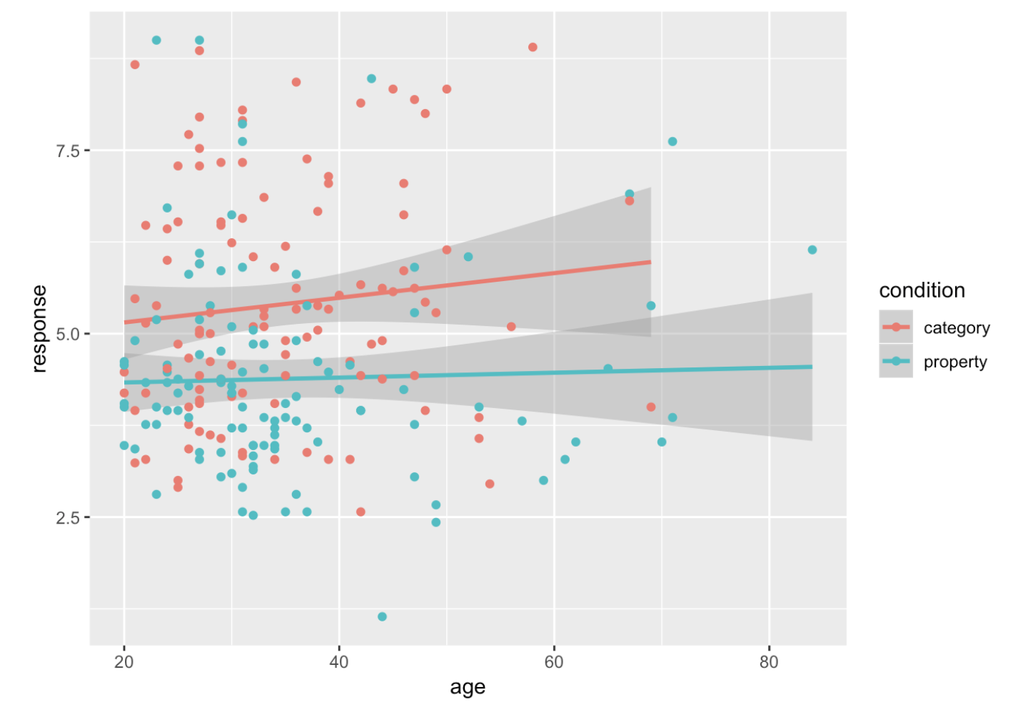
Multiple predictors

Slide 32
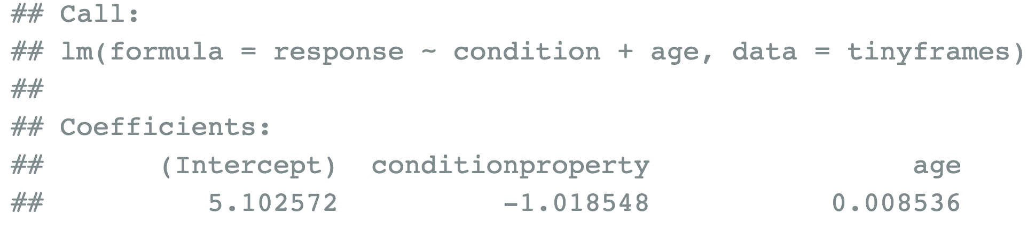
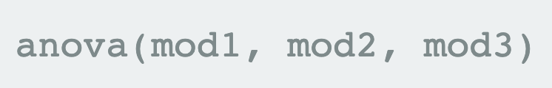
Multiple predictors
mod3:
Model selection:

Slide 33


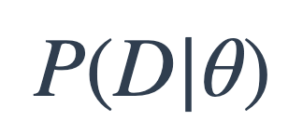
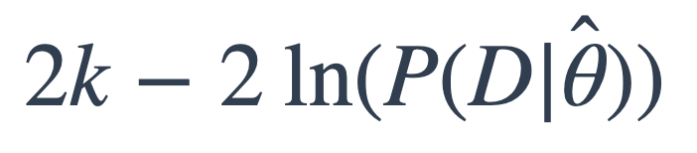
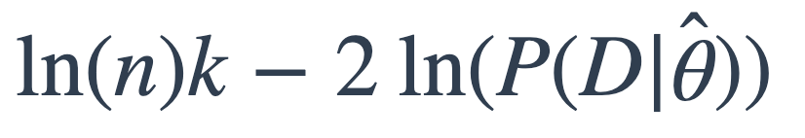
Model comparison with AIC and BIC
For model with parameters
Find that maximizes
AIC:
BIC:
where k is number of parameters,
n is number of data points

Slide 34
Model comparison with AIC and BIC
Find that maximizes
AIC:
BIC:
where k is number of parameters,
n is number of data points
Important points:
- lower is better
- both penalize model complexity (BIC has heavier penalty)

Slide 35
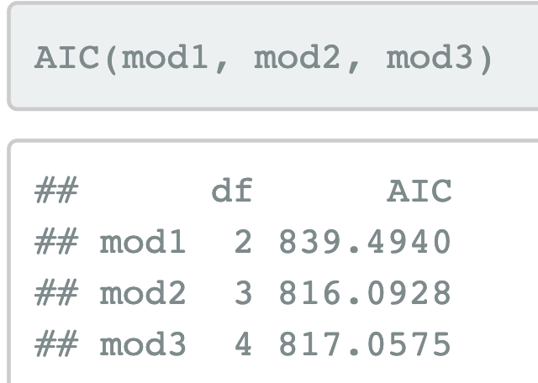
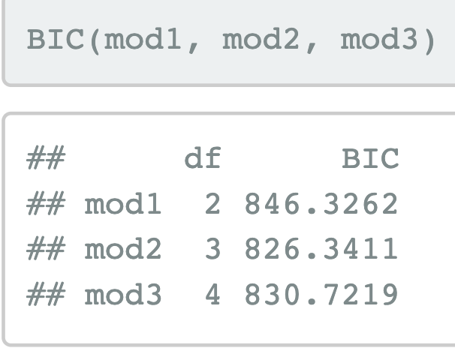
Model comparison with AIC and BIC

Slide 36
Mixed effects models
ANOVA models used to be the go-to approach in psychology, but the field is shifting to mixed-effects models.
Advantages of mixed-effects models:
extend naturally to complex situations (e.g. cases with nested structure, factors that overlap in complex ways)
deal well with missing data

Slide 37
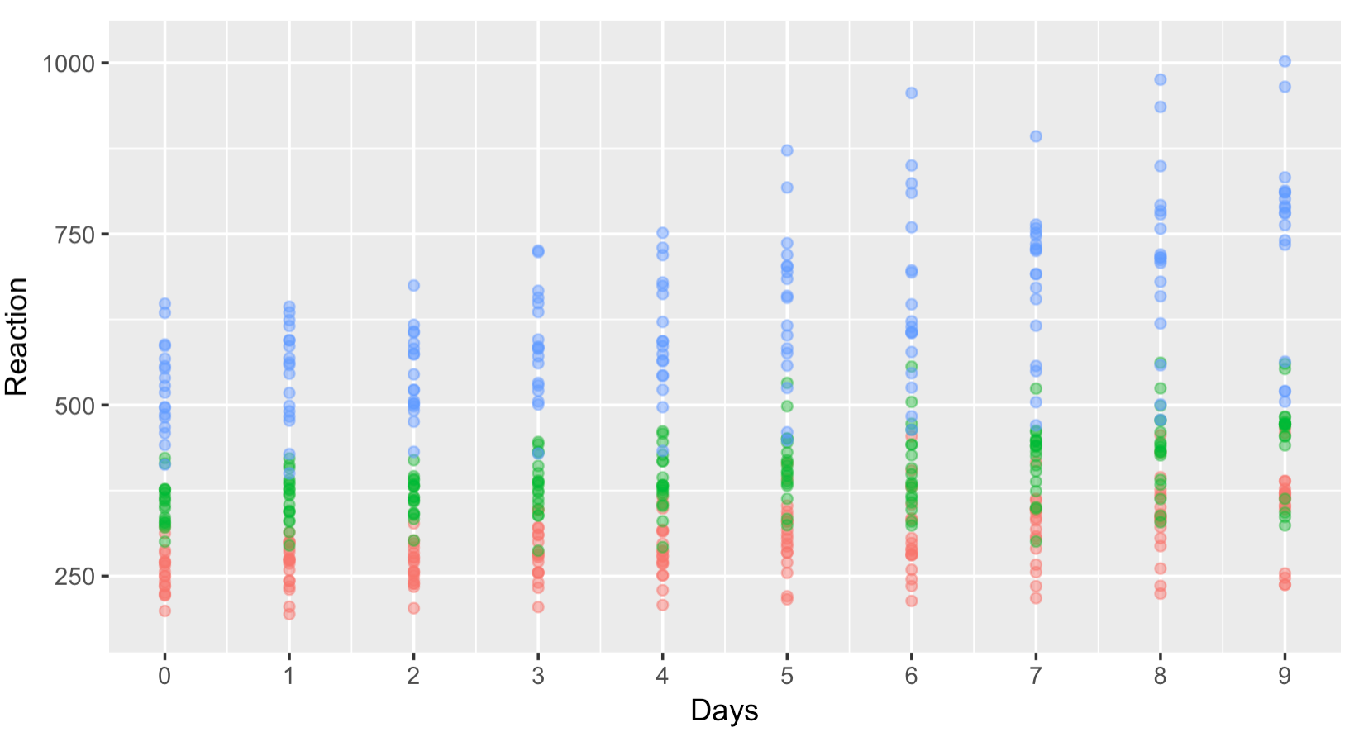
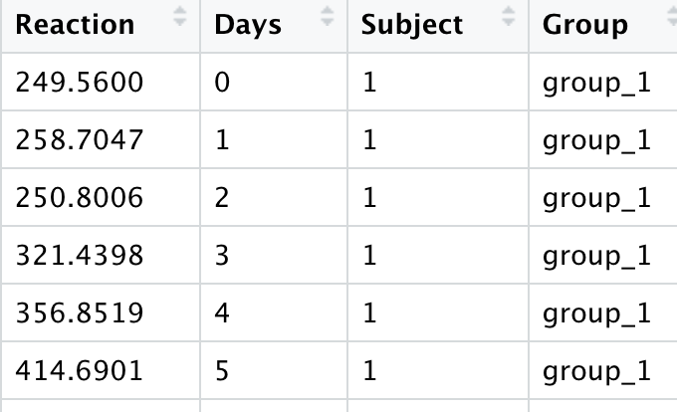
Sleep study example

Slide 38
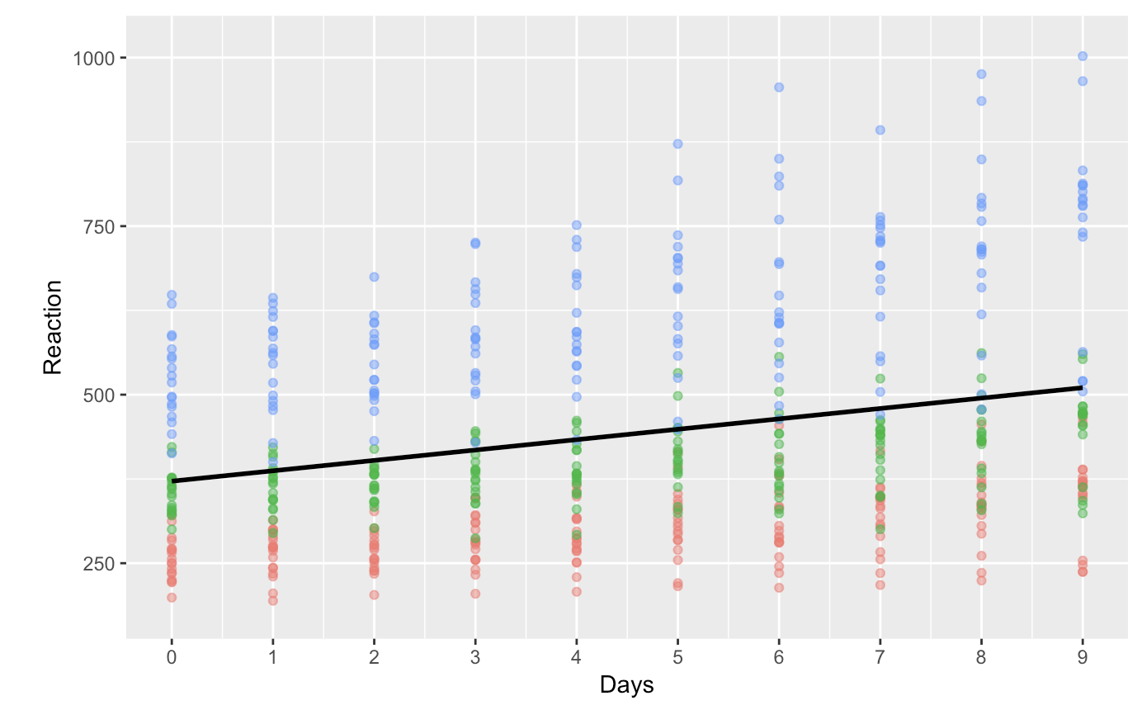
Fixed intercept, slope

Slide 39

Random intercept per group

Slide 40

Random slope per group

Slide 41

Random slope + intercept per group

Slide 42





Mixed effects models

Slide 43
Exercise

Slide 44


modestframes data

Slide 45

Model comparison
anova(modest1, modest2, modest3)

Slide 46


Model checking: individuals

Slide 47

Model checking: predictions

Slide 48

Model checking: residuals

Slide 49


frames data

Slide 50

Model comparison
linframes1:
linframes2:
anova(linframes1, linframes2)

Slide 51

Model checking: individuals

Slide 52


Generalized linear mixed models
Map response to generalization (between 0 and 1)

Slide 53
What to write up?
The actual paper reported Bayes factors computed using JASP
See analysis_samplesize.Rmd (in samplingframes/analysis) for more

